Slide 1
Neural Network
GAM 376

Slide 2
Neural Networks
ANNs (neural networks)
“Biologically inspired” computing technique developed in 1970s.
Not widely used due to the complicated nature of programming and results.
Used for very specialized set of tasks.
We will go over basic techinques

Slide 3
Overview
Neural Networks
Consists of a large number of relatively simple nodes
Nodes are to simulate, neurons.
Just like brain cells
Each neuron communicates with a subset of other artificial neurons in the network

Slide 4
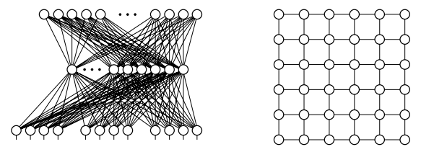
Example

Slide 5
Example
(Left Model) Shows a typical architecture for multi-layer perceptron (MLP) network.
Perceptron == artificial neuron
(Right Model) shows a Hopfield network
Network are arranged in grid

Slide 6
Neuron Algorithm
Neuron
Takes in a set of inputs, processes and returns a single output value (usually a float)
Has some state
Algorithm controls how neuron should generate a state based on inputs
In MLP, output state is passed to next layer
Each neuron is run in parallel
Or at least simulated (run in turn)

Slide 7
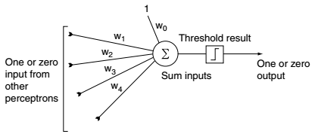
Neuron Algorithm
Each Neuron can have different algorithms
We treat each neuron as an individual entity running its algorithm

Slide 8
Neuron Algorithm
Process all inputs (can be weighted) returning a output value
Output value can in turn be a input value farther down the network

Slide 9
Learning
Without the learning aspect, it works as a very sophisticated hierarchal state machine
In MLP,
Normal Mode:
Input passed to input layer
Neuron processes input
Output passed to output layer

Slide 10
Learning
In ML,
Normal Mode:
Everything is processed forward
Learning Mode:
Everything is processed backwards
Start with output, and is back fed through the network
Called Backpropagation

Slide 11
Example
Take a Bot in a Team Deathmatch scenario
5 v 5 Deathmatch
19 Input Values
Distance to nearest 5 enemies
Distance to nearest 4 friends
Health of 4 Friends
Ammo of 4 Friends
Our health
Our Ammo

Slide 12
Example
5 output behaviors
Run away
Fight Valiantly
Heal Friend
Hunt Enemy
Find Power-up
Assume initial set of 20 to 100 scenarios
Each one a set of inputs with output we would like to see

Slide 13
Example
Network 3 Layers
Input Layer
Number of Nodes: 19
Output Layer
Number of possible outputs: 5
Intermediate (hidden) layer
Usually has minimum size of the input layer but possible more.

Slide 14
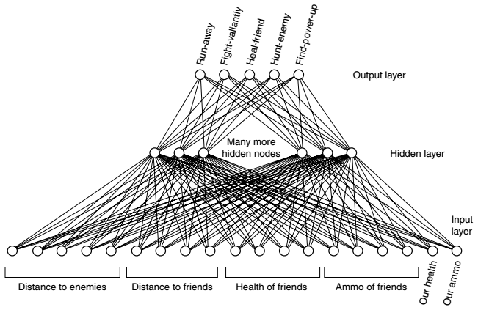
Example

Slide 15
Example
Scenarios are split into two groups
Training set (learning)
Testing set (check on how learning is going)
10 training and 10 testing for this example would be minimum
50 would be better

Slide 16
Setup and Framework
Start by initializing all weights to small random values
Then process each scenario (Two Steps)
Feedforward
Takes input and guesses an output
Backpropagation
Modifies the network based on the real output and the guess

Slide 17
Setup and Framework
After each iteration is complete
Network has learned
Test if the learning was successful
This is done by running feedforward process on the test set of examples.
If guessed output matches the output were looking for
Then good sign the network has learned properly.

Slide 18
Feedforward
Generate an output from input values
Set the states input layer neurons directly
For each neueron (in hidden layer)
We perform its Algorithm
Summing weighted inputs
Applying a threshold function
Generating its output
Can perform same process on output layer

Slide 19
Backpropagation
To learn
Compare the state of the output nodes with the current pattern
Desired output is zero for all output nodes, except one corresponding desired action
Work backward layer at a time form output layer, updating all weights

Slide 20
Genetic Algorithm
Popular Method with Neural Networks
Supervised Learning Algo
Idea
Run multiple test over time (random inputs)
Run a fixed amount neural networks
Some test will perform better then others.
Use the results of the better test to direct future tests.

Slide 21
Genetic Algorithm
Algorithm
Creates a population of random genomes
Genomes is the set containing all weights from a individual run of the NN with a fitness goal
Scores each genome based on a goal. Called fitness
Selects and breeds the best members of the population to produce more genomes
Mutates some of the members randomly to attempt to find even better candidates
Kills off the rest
Repeat step 2.
Each iteration through these steps is called a generation

Slide 22
Applying GA to NN
Goal is tune following parameters
Number of layers
Neurons per layer
Inputs

Slide 23
GA Deeper Look
Initialize N random networks to create our population.
Score each network.
Takes time
We have to train the weights of each network and then see how well it performs.
Sort best Genomes
Sort all the networks in our population by score (accuracy). We’ll keep some percentage of the top networks to become part of the next generation and to breed children.

Slide 24
GA Deeper Look
Randomly keep a few of the non-top networks
Potentially keeps some lucky combinations between worse and best performers
Also helps prevents local maximums
Breed those networks

Slide 25
GA Breeding
Takes 2 members of the population and generate one or more children.
Parents represents a combination of its parents
In NN,
Child is a combo of random assortment of parameters from its parents.
i.e.
One child might have the same number layers as its mother and rest of its parameters from its father.
2nd child might have the exact opposite.

